Slide 1
DBA training

Slide 2
Who am I?
Yannick Liekens
Games
Hiking
Dog person
Work
Orginally planned to be .Net guy
Accidental DBA
Actual DBA

Slide 3
Agenda
SQL Server: From top to bottom
Configuration
Backup & Restore
Security within SQL Server
High availability in SQL
Monitoring & maintenance
Gotta go fast!
Anti patterns
What’s new in 2022?

Slide 4
Want to follow?
Download the stack overflow data: Download the Current Stack Overflow Database for Free (2021-02) - Brent Ozar Unlimited®
Download SSMS : https://learn.microsoft.com/en-us/sql/ssms/download-sql-server-management-studio-ssms?view=sql-server-ver16
Download SQL Server developer : https://www.microsoft.com/en-us/sql-server/sql-server-downloads
Download files from github YannickLiekens/DBATraining (github.com)

Slide 5

What makes a good DBA?

Slide 6
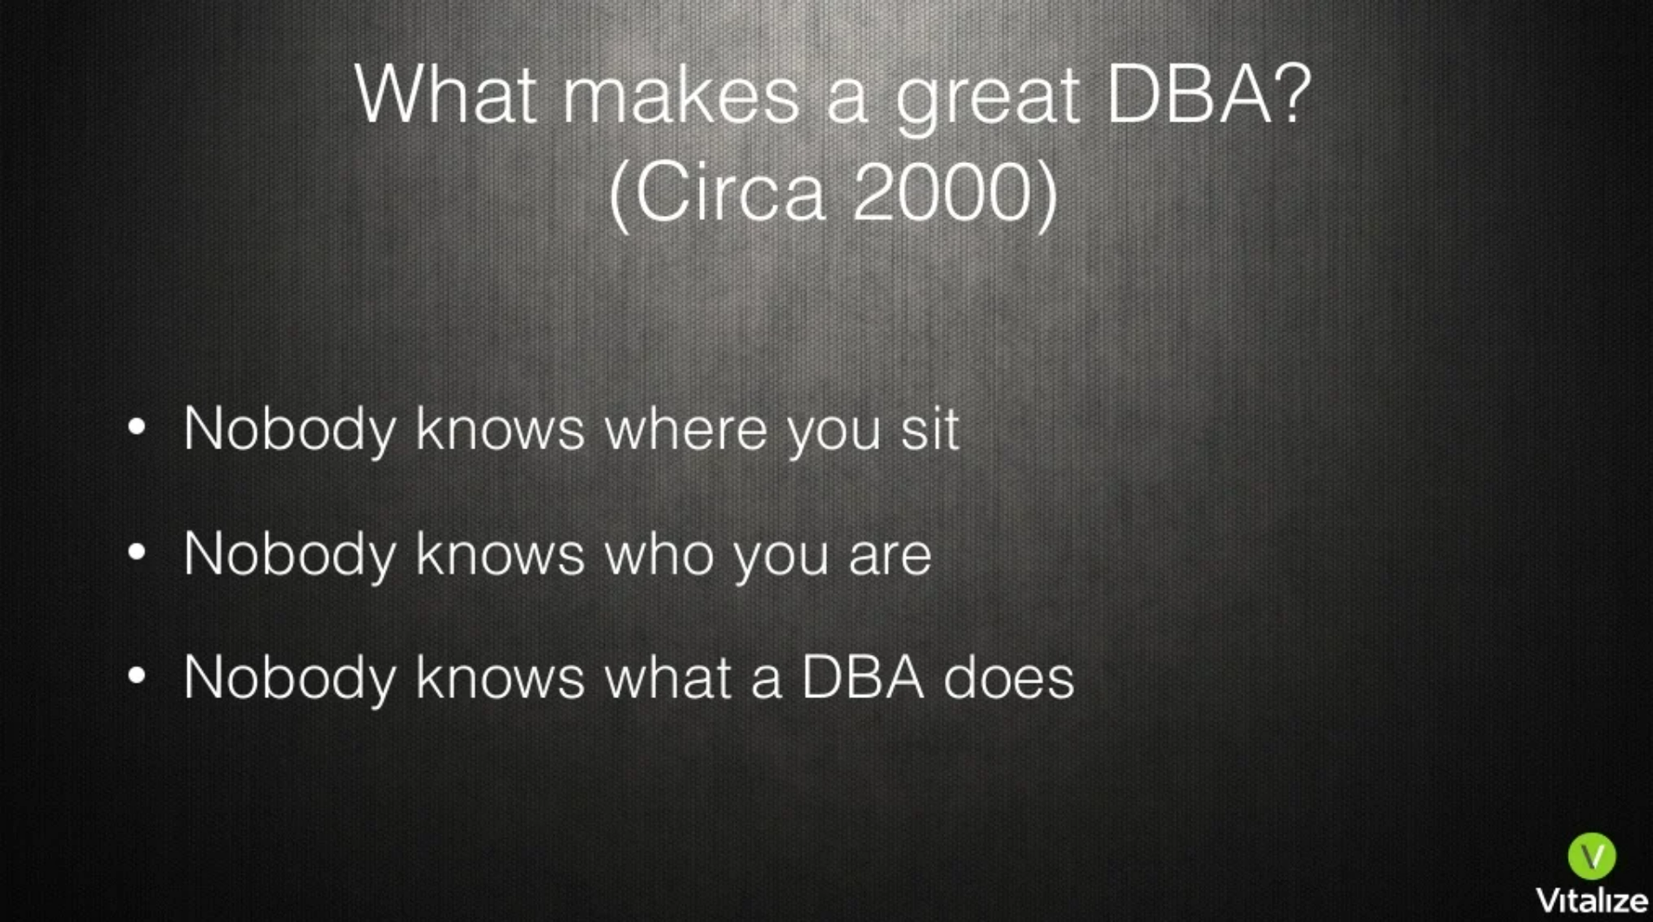
Notes:
https://www.slideshare.net/SeanScott5/the-dba-30-upgrade
- Sean Scott 2017 (Oracle DBA)

Slide 7
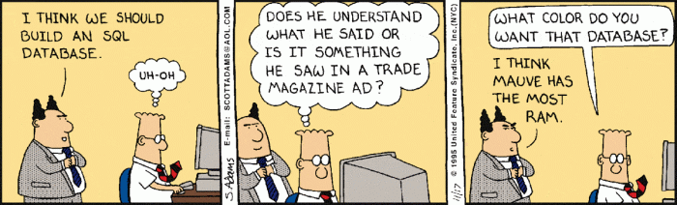
SQL Server: From top
To bottom

Slide 8
SQL Server Editions
Enterprise
All features
Developer
All enterprise features
Standard Edition
Max 128GB Memory
Max 4 sockets – 24 Cores
Few other limitations
Express edition
Only 1 GB of memory
1 Socket or 4 cores
10 GB Size
No SQL Agent

Slide 9
SQL Server versions
SQL 2014
(almost end of life)
New cardinality estimator
SQL 2016
Enterprise features on standard
Querystore
Availability groups
SQL 2017
Linux
Wait types in Querystore
Start of Intelligent query processing suite
SQL 2019
Intelligent query processing suite imporovements
SQL 2022
Improvements to IQPS
Parameter sniffing fixes
Contained availability groups

Slide 10
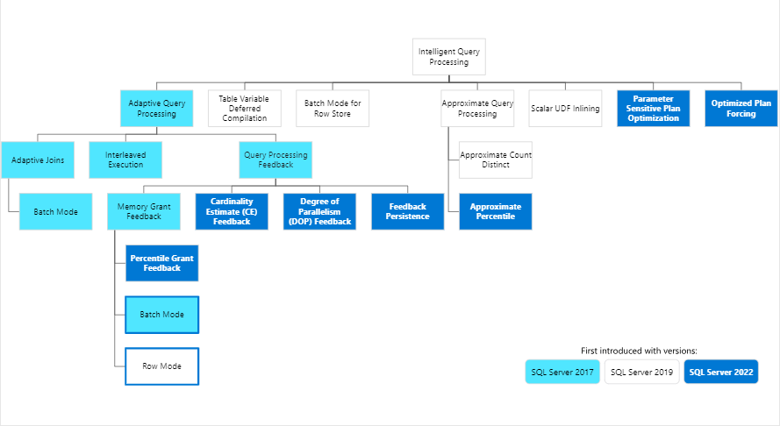
Intelligent query processing suite

Slide 11
How to license
Dev – Test – Acceptance : Developer edition
Prod
Core licenses
Server license + CAL
License VM or physical cores
Software assurance
VM vs physical
Always check with SQL License guide AND account manager!

Slide 12
SQL Server Instances
Default instance
MSSQLSERVER
Maximum 1 per server
Named instance
<InsertNameHere>

Slide 13
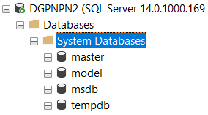
System databases
Master
System level information
System wide configuration settings
Location from database files
No master = no server
Model
Template
MSDB
SQL Agent
Jobs
Backup history

Slide 14

System databases - TempDB
TempDB
Created on restart
Used by all databases
On fast storage
Workhorse of SQL
Junkyard of SQL

Slide 15
Install SQL Server 2019
Notes:
Configuratie
TempDB
MaxDOP
Min/Max memory

Slide 16
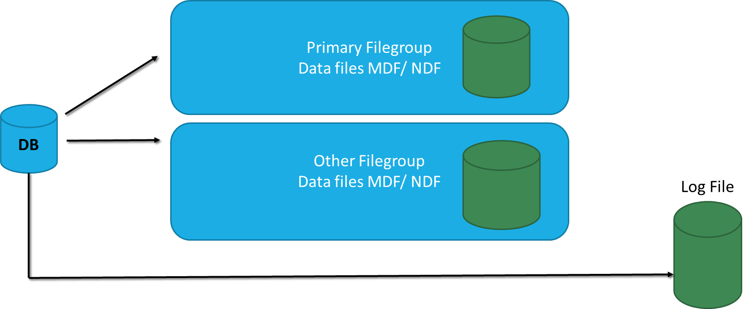
Database building blocks
Datafile
MDF
NDF
Logfile
LDF
Notes:
Meerdere files kunnen ook verspreid worden over meerdere disken, om zo de schrijf of lees snelheid te verhogen

Slide 17
The structure
Pages
Extents
Database
Notes:
Pages: 8KB
Extents: 8 Pages vormen samen een extent
Database: Meerdere extents samen vormen een database file
Types van pages:
Data
Index
Text/Image
GMAP (Global Allocation Map) SGAP (Shared Global Allocation Map) – Info on where extents are
PFS (Page Free Space)
Index Allocation Map (Extent info about table or index per allocation unit)
Bulk Changed Map (Extent info modified by bulk operations since last Log backup)
Differential Changed Map (Extent info about changes since last backup statement per allocation unit)

Slide 18
Database states
ONLINE
OFFLINE
RESTORING
RECOVERING
RECOVERY PENDING
SUSPECT
EMERGENCY

Slide 19
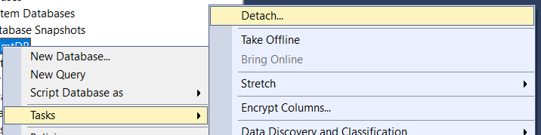
Moving a database
Detach/attach
Database not available anymore in current SQL Server
Moves the database
Datafile and Logfile intact
Drop connections before detaching
Backup/restore
Database available in both SQL Servers
Copies the database
Online operation

Slide 20
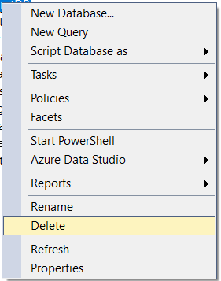
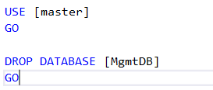
Deleting a database
Deletes database and physical files
Database offline
Physical files remain on the server

Slide 21

Configuration
Where to start

Slide 22
Windows Server configurations
Service account
Power options
Disk blocksize 64 KB (Extend)
Security policies
Instant file initialization
Kerberos authentication
Notes:
Indien Lock pages in memory ingesteld wordt > Min/max memory zeker goed instellen

Slide 23
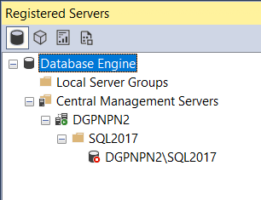
SQL Server configuration
Management server
Management database
Min/max memory settings
Maximum degree of parallelism & Cost threshold of parallelism
Alerts
Do you need an inventory?
Index fill factor
Compress backup

Slide 24
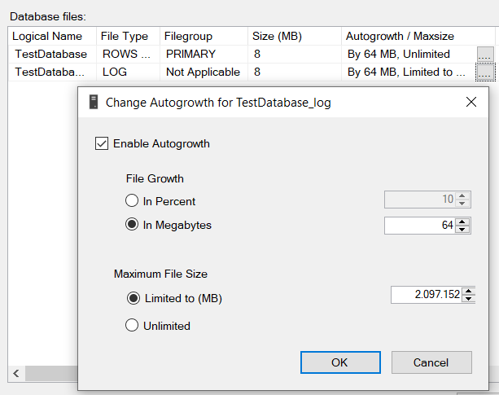
Database configuration
Autogrowth
Avoid percentage growth
Auto create/update statistics
Page verify: Checksum
Compatibility level
Prefer latest

Slide 25
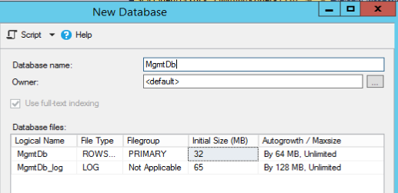
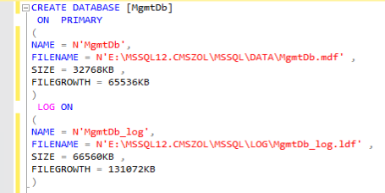
Create MgnmtDb database

Slide 26
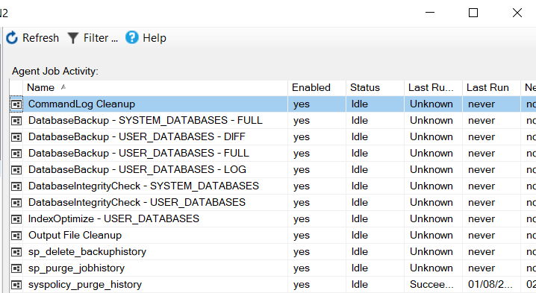
Maintenance jobs
Maintenance jobs
Index maintenance
Integrity checks
Database backups
Ola Hallengren
https://ola.hallengren.com/

Slide 27
Try to stay ahead – Integrity check
Checks the logical and physical integrity of all the objects in the specified database by performing the following operations:
DBCC Checkalloc on database
DBCC Checktable on tables and views
DBCC Checkcatalog on database
…
Supported for memory-optimized tables
Only checks physical components

Slide 28
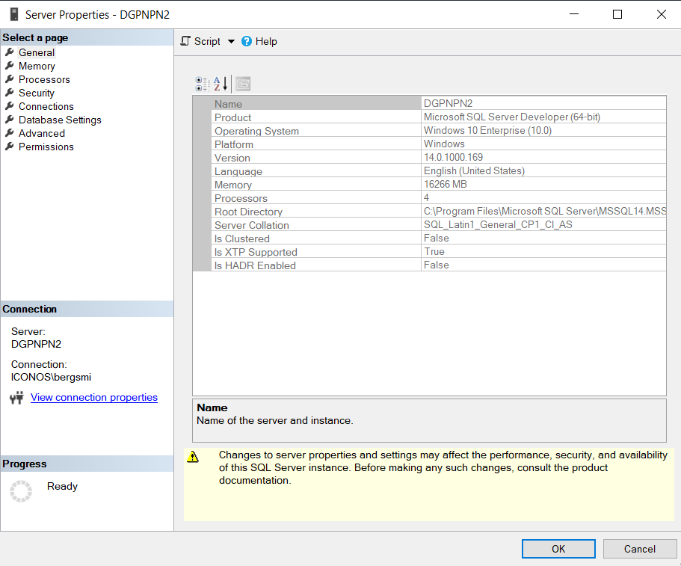
Let’s do this!

Slide 29

It’s all gone!

Slide 30
Backups - Recovery models
Recovery Model | Description
Simple | Does not permit or require log backups Automatically truncates log to keep space requirements small
Full | Requires log backups for manageability Avoids data loss due to a damaged or missing data file Permits recovery to a specified point in time
Bulk Logged | Requires log backups for manageability Can enhance the performance of bulk copy operations Reduces log space usage by using minimal logging for many bulk operations

Slide 31
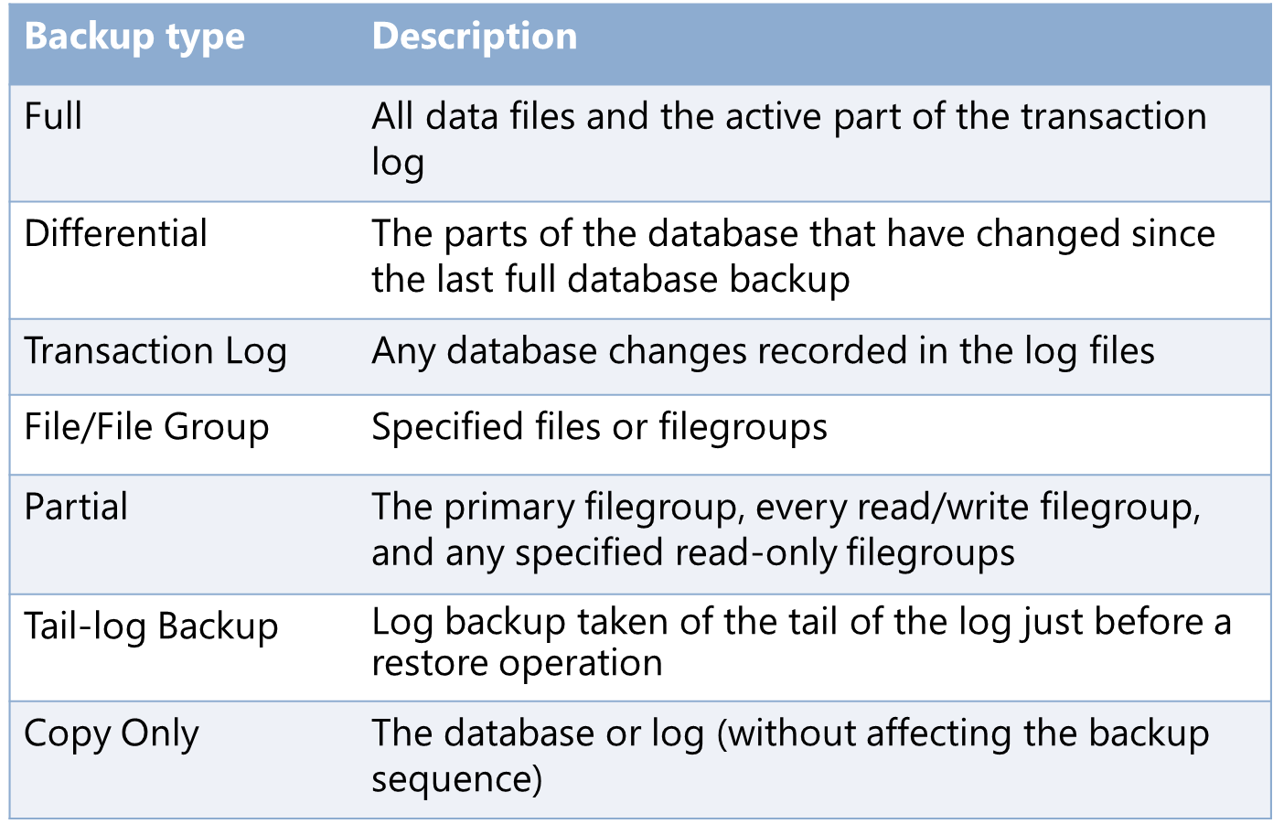
Backups - Different types
Notes:
As the name implies, a full database backup contains the entire database. It contains the data files of a database, and the active portion of the transaction log as at the end of the backup.
A differential database backup contains the changed data pages since the last full database backup, and the active portion of the transaction log as at the end of the backup.
A transaction log backup backs up the transaction log records that have not yet been backed up, up to the last log record that exists at the time the backup ends. You can only perform a transaction log backup if your database is running the full or bulk-logged recovery models.

Slide 32
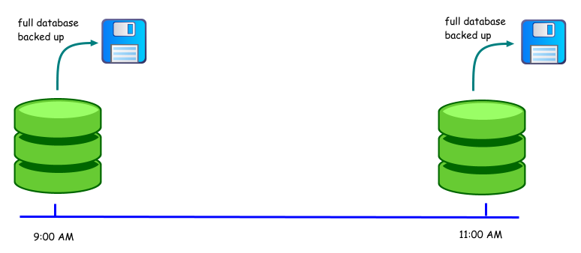
Simple recovery mode

Slide 33
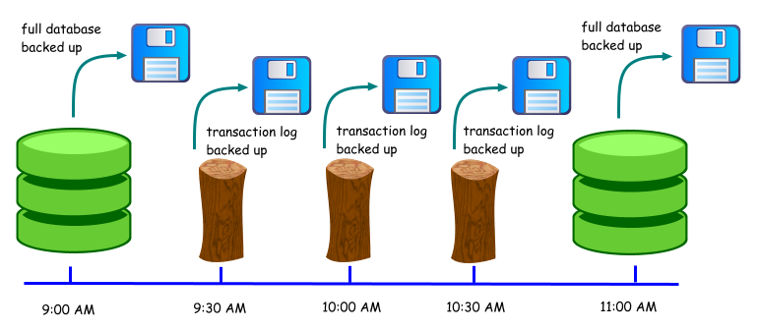
Full recovery mode

Slide 34
Backups
Full backup
Contains all data
Base for other backup
Slow
Any recovery model
Diff backup
Depends on full backup
Contains data since last Full backup
Faster than Full backup
Any recovery model
Log backup
Depends on full or diff backup
Contains data since last backup
Small & fast
Full or Bulk-logged recovery model

Slide 35
COPY_ONLY
Very important when taking non production copies
Often forgotten when using multiple backup mechanisms (Veeam + SQL)

Slide 36
SQL Back-ups
T-SQL
Ola Hallengren
Veeam
TSM
Rubrik
...

Slide 37
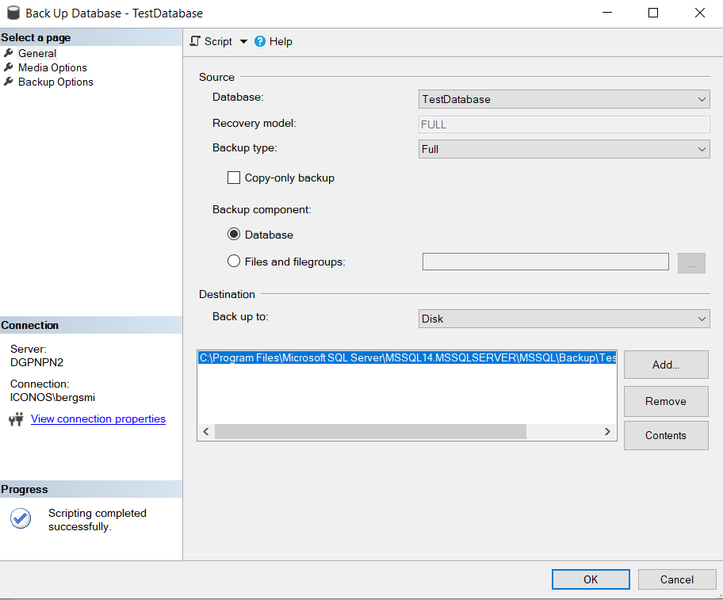
Database backup

Slide 38
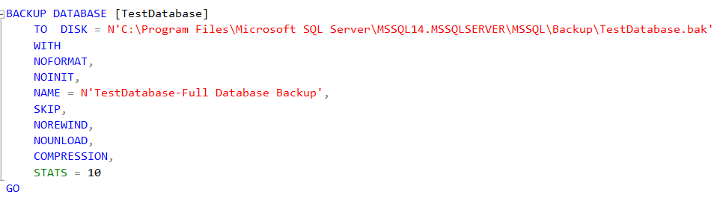
Database backup

Slide 39
Restore
Full Backup
Differential
Backup
Log Backup(s)

Slide 40
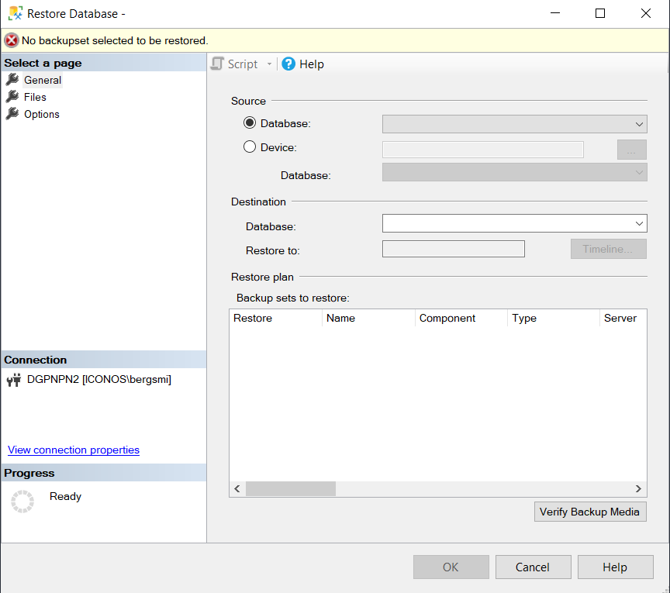
Restore

Slide 41
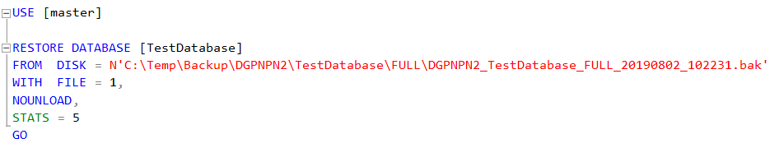
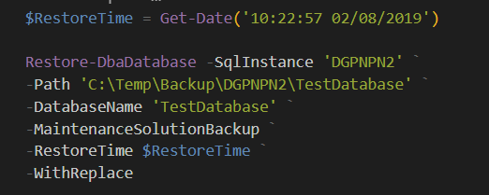
Restore

Slide 42
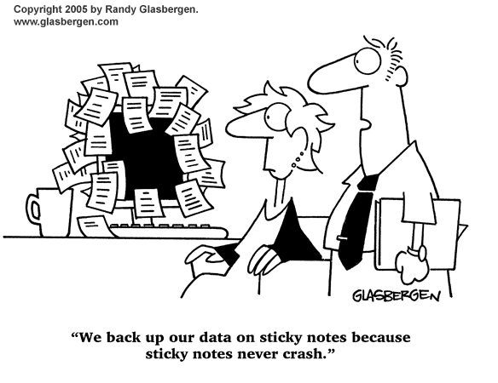
Let’s restore & back-up our database

Slide 43
Security

Slide 44
Some terminology
What | Description
Principal | Entity request access to resource
Securable | Resource to be secured or object
Authentication | Who is principal
Authorization | Provides acces to securable for a principal
Role | Container for principals. Indirectly assigning permissions
Permissions | The actions principals can perform on securable

Slide 45

Security
Security Hierarchies:
Securables can contain other securables
Principals can contain other principals
Permissions are inherited unless overridden

Slide 46






Securables
SQL Server Instance
Server-level objects
Database
Database
Database-level objects
Database-level objects
Schema
Schema
Schema
Schema
Objects
Objects
Objects
Objects

Slide 47
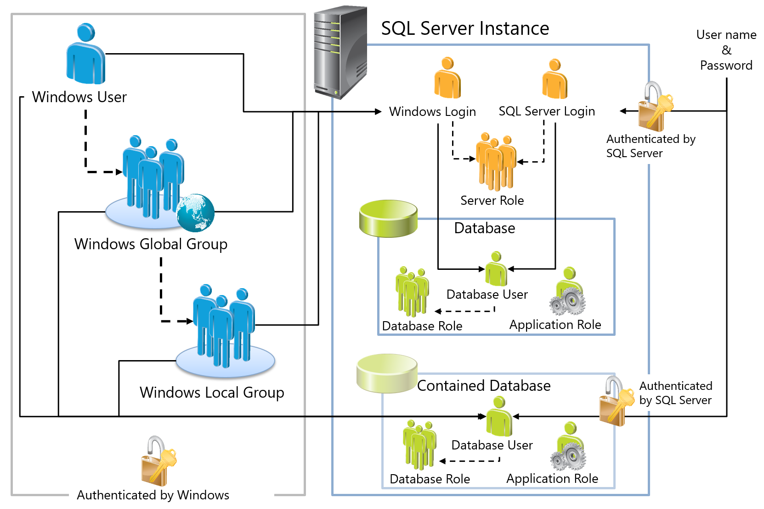

Slide 48
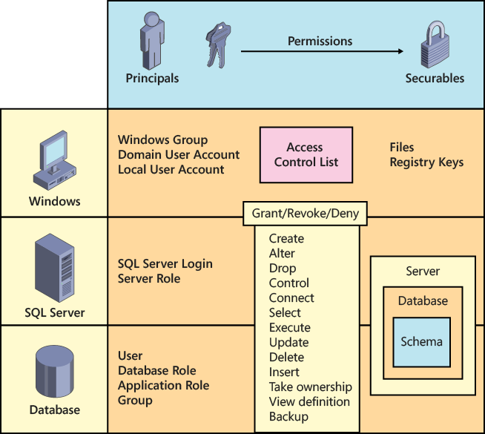
Permissions

Slide 49
Authentication
Windows Authentication mode
Only active directory users
SQL Server and Windows Authentication mode
Active directory users
SQL Users

Slide 50
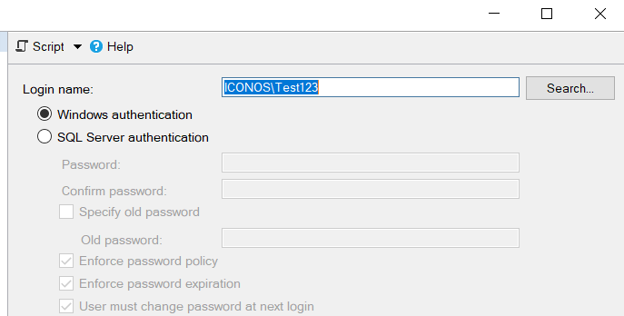
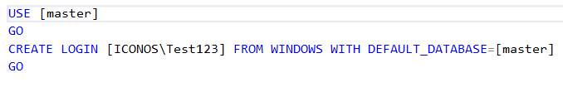
Windows user or group

Slide 51
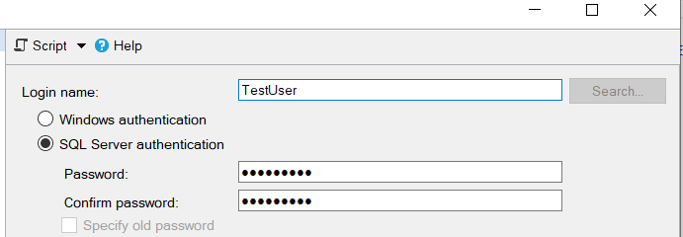
SQL user
SID IS VERY IMPORTANT

Slide 52
Database user
Instance
Login
Database
User
BEST PRACTICE : LOGIN NAME = USER NAME

Slide 53
Special user DBO
Can’t be deleted
Can do everything in any database
Members of the sysadmin role and sa are mapped to this user

Slide 54
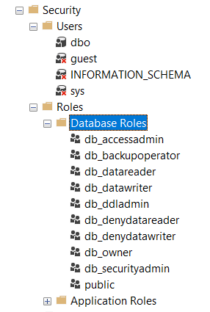
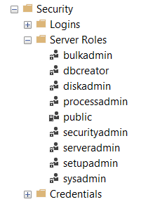
Security roles
Database roles
Server roles

Slide 55

Best practices
Notes:
Best practices for authentication mode and logins
Always use Windows Authentication mode if possible.
Use Mixed Mode Authentication only for legacy applications, non-Windows users, and users from untrusted domains.
Use the standard login DDL statements instead of the compatibility system procedures.
It the sa account is not going to be used, you should disable it. Change the sa account password to a known value if you might ever need to use it. Always use a strong password for the sa account and change the sa account password periodically.
Do not manage SQL Server by using the sa login account; assign sysadmin privilege to a knows user or group.
Rename the sa account to a different account name to prevent attacks on the sa account by name.
Do not delete internal built-in logins
Use Windows Logins rather than Windows Group to control access to SQL Server and use care when using Windows Group logins to prevent group overlap for a particular user.
Use login triggers for more granular control of the login process.
Mandate a strong password policy, including an expiration and a complexity policy for your organization.
If you must use SQL logins, use password policies.
Outfit your applications with a mechanism to change SQL login passwords.
Set MUST_CHANGE for new logins.

Slide 56


Slide 57
SQL Server audit
What is happening on my SQL Server?
Demo!

Slide 58
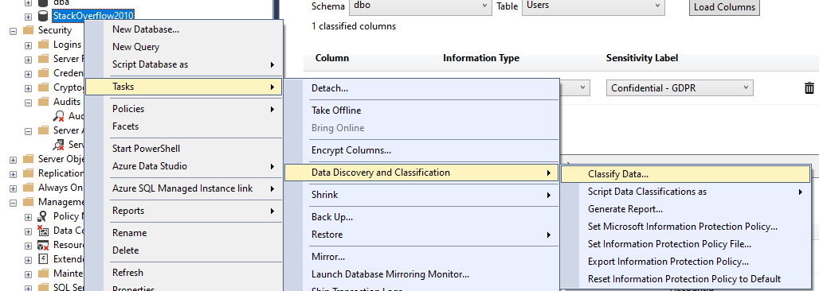
Database classification

Slide 59
Let’s give access!
Notes:
We hebben een gebruiker die enkel moet controleren wanneer er backups gefaald zijn. Hij hoeft geen toegang te hebben tot de jobs zelf.
Aangezien we Ola Hallengren zijn scripts gebruiken, is de log tabel terug te vinden in onze MgmtDB. We geven de user enkel rechten om deze tabel te lezen.

Slide 60
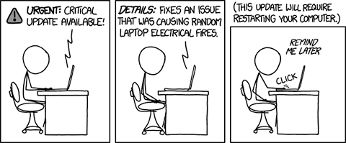
Alert: No downtime allowed!

Slide 61
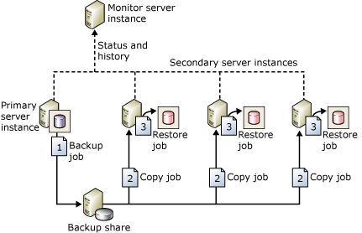
Log shipping

Slide 62
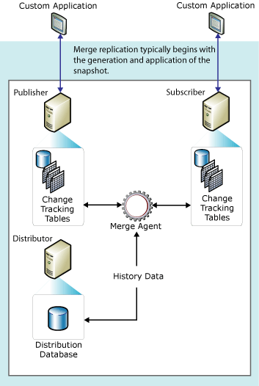
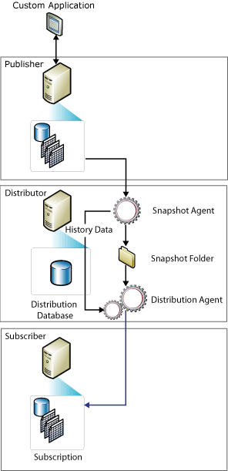
Replication

Slide 63
Merge replication

Slide 64
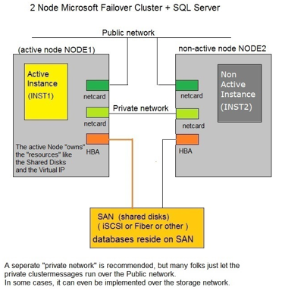
Windows failover cluster (FCI)
Clustering = Windows Feature
Shared storage

Slide 65
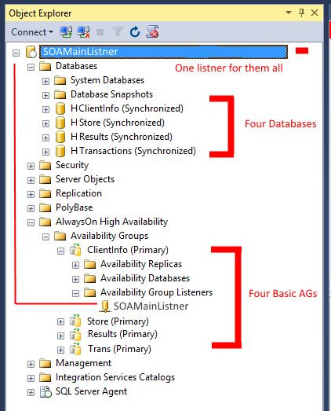
Basic availability groups
Since SQL 2016
Limited to 1 database per group
Limited to 2 servers
No back-ups from secondary
No readable secondary

Slide 66

Always On – Synchronous commit mode
1 Commit
7 Acknowledge
6 Acknowledge
Constantly Redoing on Replica
2 Transmit to Replica
2 Write to Local Log
3 Committed in Log
4 Write to Remote Log
5
DB
Log
Log
DB

Slide 67
Always On – Asynchronous commit mode
1 Commit
4 Acknowledge
7 Acknowledge
Constantly Redoing on Replica
2 Transmit to Replica
2 Write to Local Log
3 Committed in Log
5 Write to Remote Log
6
DB
Log
Log
DB

Slide 68
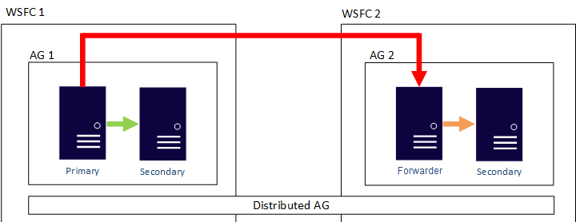
Distributed Always On

Slide 69
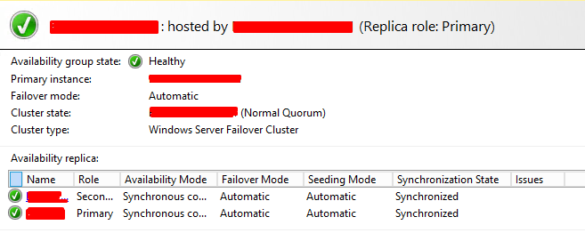

Slide 70
Let’s see!
Notes:
Laat verschillende HA opties zien

Slide 71


Did nobody automate this?
https://dbatools.io/

Slide 72
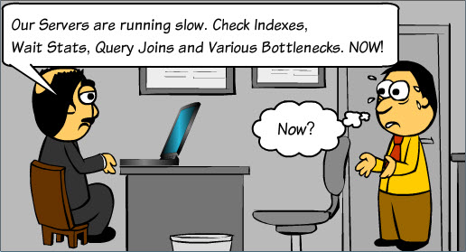
The database is slow!

Slide 73
What are our options
SentryOne/Redgate/DbaDash Or other tools
QueryStore
Sp_whoisactive
Windows error log
Sp_Blitz
Extended events
Profiler
Activity monitor
DMV/DMF
Notes:
Volgorde waarin ik meestal begin met troubleshooten
DMV: https://glennsqlperformance.com/resources/
Blitz : https://github.com/BrentOzarULTD/SQL-Server-First-Responder-Kit

Slide 74
Extended events vs profiler
GUI
Overhead
Async vs sync capture
Causality tracking
Many many more events

Slide 75
Let’s show
Notes:
SentryOne laten zien van Fanuc/Profel?
Aantal DMV’s laten zien
SQL Error log induiken
SP_BlitzFirst
SP_Whoisactive

Slide 76
Agenda
Recap
SQL Patching – risk vs benefit
SQL Alerts
How does the engine work
Exercise
Anti patterns – Tips and tricks
Look around own environnement
Blitz - Cache – Index
QueryStore
Recap exercise
Questions

Slide 77
Recap
Installation
Service accounts / Drives / Instant file initialisation
System databases
Ola hallengren
Configuration
Max dop/cost threshold
Compatability levels
Backups
Security
AD vs SQL login (SID)
High availability
Log shipping
Always On (Availability groups)
Monitoring
WhoIsActive
Glenn barry scripts
Querystore
Extended events
SQL Audit

Slide 78
SQL Alerts
Monitor Severity 16 – 25
823,824 and 825
Error Number Range | Description
0 – 9 | Information Messages
10 | Information or non severe errors
11 to 16 | Errors can be resolved by users
17 to 19 | Software errors cannot corrected by users
20 to 24 | Serious System errors
25 | SQL service terminating error

Slide 79
Patching
https://sqlserverupdates.com/
Risk vs reward
2019 early CUs gave a lot of issues
But, lots of security updates, fixes

Slide 80
How does the engine work
Notes:
SentryOne laten zien van Fanuc/Profel?
Aantal DMV’s laten zien
SQL Error log induiken
SP_BlitzFirst
SP_Whoisactive

Slide 81
How does the engine work?
Look at clustered key page
Note about me (nvarchar(max))
In a perfect world:
Queries are easy
Data only on one page
SQL Knows which page
SQL can jump to that page
SQL can read as is, no manipulations

Slide 82


Slide 83
What the engine needs to do
Guess which rows the query wants
Guess which pages have those rows
Guess what will be the most efficient way to get them
Guess which tables should be processed first
Guess how much resources we should allocate

Slide 84
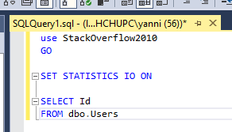
How does SQL do the following?

Slide 85
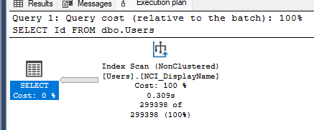
Result

Slide 86
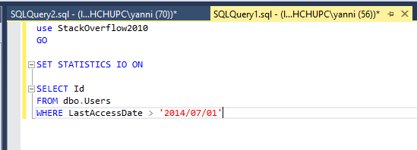
Adding a filter, what now?

Slide 87
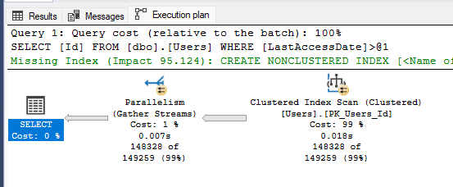

Slide 88
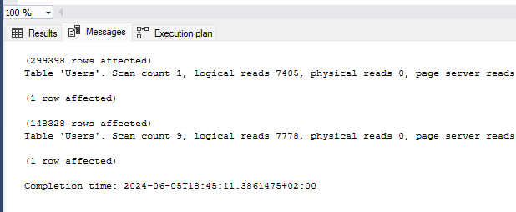
Slightly more work

Slide 89
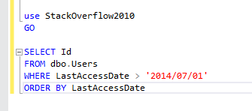
Let’s add a sort
How does the engine do it now?

Slide 90
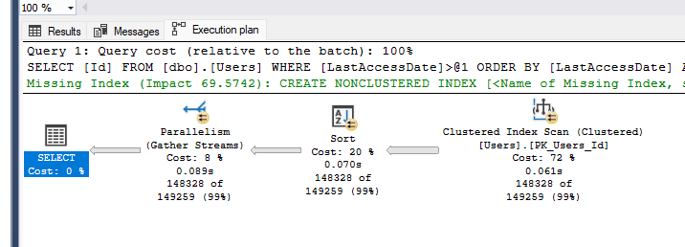
Sort operator: ID + LastAccessDate in memory
Notice the memory grant, by default 25% of max memory can be given PER QUERY
Memory is given BEFORE execution

Slide 91
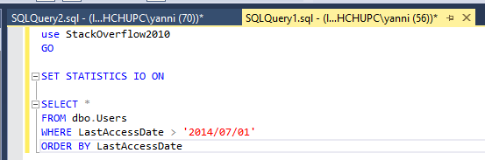
Fetch all the fields, is there a difference now?

Slide 92
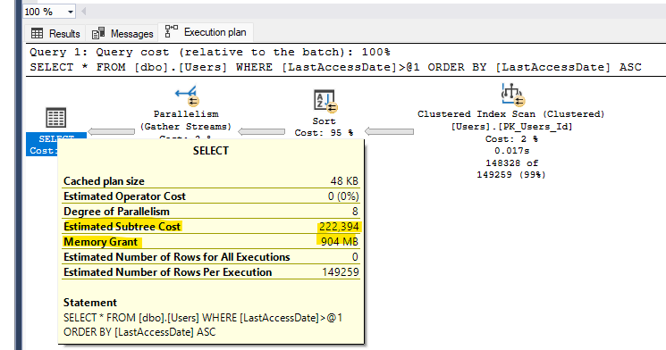
Oh oh

Slide 93
Pointers
Careful about column you don’t need.
Sort in the app layer if possible
SQL licenses are EXPENSIVE, app servers are cheap.

Slide 94
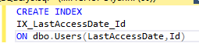
Non clustered index, more of the same but different
Just a copy, with chosen columns
What about insert/update/delete performance?

Slide 95

Let’s try the query again

Slide 96

Way easier

Slide 97


Only less reads?

Slide 98
Covering index
The index we have now contains ALL of the columns needed

Slide 99

Seek bad, scan good?
No.
Seek – Start at a row and continue until satisfied
Scan – Start at the start or end and work through until satisfied
Surely StackOverflow exists in 1800

Slide 100

Scans can be good!

Slide 101

Adding some columns,how would we do this?

Slide 102

Solution 1
Grab IX_LastAccessDate_Id, seek to 2014/07/01
Write down the Id and lastAccessDate of matching records
Grab the clustered index (white pages) and look up each matching row by their ids to get DisplayName and Age

Slide 103
This is why SQL includes the clustered key in EVERY index.
Lookup happens for every single row , can be VERY expensive

Slide 104

Cheated on the date, in reality we scan.
Tipping point, lookups expensive

Slide 105



If we “hint” SQL to use the lookup

Slide 106

SQL Server cost based Optimizer
Build a plan
Sum up the cost of all its operators
Is there another possible plan?
Repeat 1
Take the lowest cost plan

Slide 107

What if SQL made the wrong choice?
☺
Plans should be good enough, perfect plans would cost a lot
Possible to get timeout before finding a “good enough plan”
The engine uses statistics to make these estimates
Each index is 1 single page, SQL uses for this everything

Slide 108

How does it look like

Slide 109

Actual vs estimate plan

Slide 110
What can go wrong?
Statistics can be outdated
Stats can be poorly sampled
Queries may be complicated to understand
If you don’t get it, neither will the engine.

Slide 111

Same query results.
Same plan?

Slide 112

Ouch

Slide 113

Key lookups classic tuning sign
Is required when index doesn’t have all of the columns we need.
Look at output of the operator, these are the columns it fetches.
Small fields, not updated frequently? Add them.

Slide 114


New index, and, do we still need all?
Notice less data on the page
We now have 3 copies of the data
sp_blitzindex @TableName = 'Users'

Slide 115
More indexes
More space in memory
More space on disk
Longer backups/restores/checkdb
Longer inserts updates deletes
Longer index maintenance

Slide 116
Warning signs
Too many indexes:
People complain about inserts/updates/deletes performance
Big database sizes
Not enough indexes:
People complain about slow selects
You can cache a ton of data

Slide 117
INCLUDES
Are not part of the key
Still on same 8KB page
In theory more lightweight since not sorted
In practice, difference is very minor to none. Same data on page

Slide 118
General tips
Order of the first 1-2 columns, first is VERY important
Add columns you need to the index
5x5 “rule”
Most selective columns first
WHERE/GROUP BY/JOIN/ORDER are good to index
SELECT (lookups) often less important -> include can be used

Slide 119

What are indexes?
Clustered Index
Non-Clustered Index
Notes:
Zie een index als een inhoudstabel in een boek of als een telefoonboek.
Wanneer je een bepaalde pagina zoekt, kun je in de inhoudstabel gaan kijken waar deze zich ongeveer bevindt.
Wanneer je iemand zoekt van de stad Hamont, zoek je eerst naar Hamont en dan pas op achternaam.
Dit kun je een beetje vergelijken als een index. Wanneer we vergelijken met een inhoudstabel van een boek, deze wordt nooit aangepast. De pagina’s blijven op dezelfde plaats staan en de inhoudstabel hoeft dus nooit aangepast te worden.
Een telefoonboek krijgt ieder paar jaar een update met nieuwe gegevens, ook de index zal dan geupdate zijn.
In SQL gaat alles een beetje sneller. Afhankelijk van de database worden indexen dagelijks of wekelijks opnieuw opgebouwd.
Page splits
Fragmentatie

Slide 120
Index – The good, the Bad and the Ugly
INSERT
Rows are also added to all nonclustered indexes
New rows are inserted in a table according to the order of the clustered index
DELETE
Rows are removed from all non-clustered indexes
Free space on the page → Fragmentation
UPDATE
Changes that have to occur in indexes depend on the columns that get changed
If the clustered index key is updated, then the row might have to be moved from one page to another
CONCLUSION:
Appropriate indexes → speed up data modifications
Numerous indexes on tables → performance may suffer
Trade off between Read and Write Performance

Slide 121
Index fragmentation
Fragmentation
Happens when database grows, pages split, and then data eventually deleted.
B-trees great on maintaining balance on insertions, but with deletes, can end up with many pages containing small # of records.
How to find fragmented indexes?
DBCC SHOWCONTIG (deprecated)
sys.dm_db_index_physical_stats
How to defragment indexes?
DBCC INDEXDEFRAG (deprecated)
ALTER INDEX
Often focused on too much, modern hardware, less important

Slide 122
Index Maintenance
Default parameters from Ola Hallengren
avg_fragmentation_in_percent value | Corrective statement
> 5% and < = 30% | ALTER INDEX REORGANIZE
> 30% | ALTER INDEX REBUILD WITH (ONLINE = ON)
Notes:
Rebuild
Rebuilding an index drops and re-creates the index.
Reclaims disk space by compacting the pages
Reorders the index rows in contiguous pages.
Reorganize
Uses minimal system resources.
Physically reordering the leaf-level pages to match the logical, left to right, order of the leaf nodes.
Compacts the index pages

Slide 123

Gotta go fast!

Slide 124


Let’s compare SQL to a car
Ariel Atom 4
0-60: 2,8 Seconds
Horsepower: 320
Weight: 600KG
Lamborghini Urus
0-60: 3,4 Seconds
Horsepower: 640
Weight: 2300KG

Slide 125
What is a SQL plan?
Sequence of steps that the engine plans to follow to execute your query
Good enough, not perfect
Has to be fast
Cached

Slide 126

How to read query plans?
Right to left
Top to bottom

Slide 127






Different operators – Seeks & Scans
Notes:
RID Lookup: ROW ID lookup > Enkel in heaps
Key Lookup: Clustered index makes sure data is stored in the table, allowing us to search by Key instead of Row ID
Stream Aggregate: AVG, Max, Min,...
Compute scalar: Concat,...
Concatenation: UNION / UNION ALL
Assert: Foreignkey check on Insert
Hash Match Aggregate: Bigger tables – Table will be built in memory and hash values calculated there
Nested join: Execute upper once, lower multiple times

Slide 128





Different operators - Joins
Notes:
RID Lookup:
Key Lookup:
Stream Aggregate: AVG, Max, Min,...
Compute scalar: Concat,...
Concatenation: UNION / UNION ALL
Assert: Foreignkey check on Insert
Hash Match Aggregate: Bigger tables – Table will be built in memory and hash values calculated there
Nested join: Execute upper once, lower multiple times

Slide 129












Different operators – Others
Notes:
RID Lookup:
Key Lookup:
Stream Aggregate: AVG, Max, Min,...
Compute scalar: Concat,...
Concatenation: UNION / UNION ALL
Assert: Foreignkey check on Insert
Hash Match Aggregate: Bigger tables – Table will be built in memory and hash values calculated there
Nested join: Execute upper once, lower multiple times
Segment: ROW_NUMBER()
Table spool: Creates temp table in a lazy way. Only with rows that are required by the parent operator

Slide 130

Estimating is hard, even for computers
Estimates don’t have to be exact, just almost correct!

Slide 131

How much does it cost?
Cost is just a number
Refers to the amount of seconds a query would take to execute on “Nick’s Machine” back on SQL 7.0 (1998 – 1999?)

Slide 132
Estimates example

Slide 133
Index tuning
Once
Remove duplicate indexes
Remove unused indexes
Sometimes
Create new indexes
Real tuning begins
Modify indexes
Add clustered index to heaps

Slide 134
De-duplicating indexes
Performance
More objects in cache
More stuff to update when inserting, updating or deleting
More data
Longer backups/restores
More maintenance required

Slide 135

Example
Notes:
Will these use different query plans?

Slide 136

Looks easy

Slide 137

The indexes that are being updated are hidden under the operator

Slide 138

WHERE Reputation = 1
Wider plan to re-sort all the data by index orders to make the delete faster

Slide 139


Slide 140
Deduplication
Identical Indexes
Remove all but 1. You don’t need more!
Almost identical:
Can you merge them?
Different include columns?
Can we add a covering index to replace others?

Slide 141

What if?

Slide 142

Merge
Notes:
Key: LastAccessDate, DisplayName, Age
Included: Reputation, Location, CreationDate

Slide 143
Let’s check index stats!

Slide 144
DBATraining_Index_Oefeningen

Slide 145
Anti patterns and parameter sniffing

Slide 146
Parameter Sniffing – What can we do?
No perfect solution
Optimize for unknown
Declare local variable
Optimize for specific value
Plan guides
Covering indexes
Option recompile
Stored procedure branching

Slide 147
What works for us?
OPTION (RECOMPILE)
OPTIMIZE FOR UNKOWN
OPTIMIZE FOR @Reputation = 1
Stored Procedure branching
Plan guide

Slide 148
Recap
How to think like the engine
Clustered vs non clustered indexes
Pages
Page splits
Insert update delete vs read performance
Parameter sniffing
Function usage
Deeper look into extended events – Query store
Practical examples

Slide 149
If you can’t understand it,
the engine won’t understand it

Slide 150
Agenda today
Continue « common mistakes » - anti patterns
Q&A
Recap exercice
Afternoon
dbaDash by Tom

Slide 151
Common “mistakes”
Functions
SARGability
Table Variables
Data types
CTE
RCSI

Slide 152
Want to know more? Some great bloggers
Erik Darling
https://erikdarling.com/
Brent Ozar
https://www.brentozar.com/
Kendra Little
https://littlekendra.com/
SQLPerformance
https://sqlperformance.com/

Slide 153
Excercice recap
Configure your SQL Server.
Min/Max memory
Backup compression default
xm_cmdshell = 0
Cost threshold of parallelism 50
Make sure master database has a set auto growth
Download ola hallengren
Setup maintenance
think of a good time when to do this
Since the business wants extra safety, take daily copy only full backups.
Application owner wants to have access to read only all of the tasks. Create a new login you can give him, give him only the permissions needed.
Setup a job that logs WhoIsActive
Install dbaTools
Copy the dba database to a dba_Archive database

